Slide 1
Interfacing Tranceiver module with Arduino UNO and Beaglebone Black
Submitted by: Mohammed Abdul Muqeeth - C0751945
Group #: 5

Slide 2
AGENDA
Task objective
Hardware used
Software used
Features of HC-12 Module
Pin configuration of HC-12 Module
Arduino UNO – HC 12 connection
BBB – HC 12 connection
Conclusion
References

Slide 3
TASK OBJECTIVE
To establish a wireless communication between the Arduino UNO and Beaglebone Black.
Transmit the data from Arduino to BBB using wireless modules.
Protocol used : UART.

Slide 4
HARDWARE USED
Arduino UNO
Beaglebone Black
HC-12 Module pair
MPU6050 gyroscope sensor
Jumper wires
Breadboard

Slide 5
SOFTWARE USED
Arduino IDE
PUTTY
C language
Vi Editor
WinScp

Slide 6
FEATURES OF HC-12 MODULE
Long distance wireless transmission (upto 1000m).
Working frequency : 433.4-473 MHz
Maximum transmitting power : 100mW
Built in MCU(stm8s003fs)
Ability to operate at higher baud rates

Slide 7
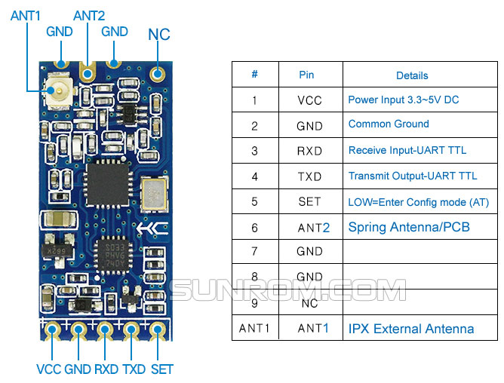
PIN CONFIGURATION OF HC-12 MODULE

Slide 8
STM8S003FS MICROCONTROLLER FEATURES
8-Bit microcontroller
8kb of lash RAM
Has 128 Bytes of EEPROM
Equipped with 10-bit ADC
Supports UART, SPI, I2C Communication

Slide 9
ADVANTAGES OF HC-12 MODULE
Range is quite impressive (1km).
Compatible for industrial applications
Very handy in tracking related projects.

Slide 10
ARDUINO UNO – HC 12 CONNECTION
ARDUINO UNO | HC 12 Module
PIN 10 | RXD
PIN 11 | TXD
VCC | VCC
GND | GND

Slide 11
BBB – HC 12 CONNECTION
BBB | HC-12 Module
P9.24 | RXD
P9.26 | TXD
SYS_VCC | VCC
GND | GND

Slide 12
CONCLUSION
A serial port communication between an Arduino UNO and BBB has been successfully established using a HC-12 Tranceiver module using UART communication protocol.

Slide 13
REFERENCES
Understanding and Implementing the HC-12 Wireless Transceiver Module - Projects. (n.d.). Retrieved November 17, 2020, from Dejan, Zeeshan November 25, Dejan Nedelkovski November 26, Mark March 2, Dejan Nedelkovski March 6, Spencer March 18, . . . Name*. (2019, December 15). Arduino and HC-12 Long Range Wireless Communication Module. Retrieved November 17, 2020, from https://howtomechatronics.com/tutorials/arduino/arduino-and-hc-12-long-range-wireless-communication-module/
How to communicate two HC12 Module with Arduino. (n.d.). Retrieved November 17, 2020, fromhttps://create.arduino.cc/projecthub/franciscomoreirapcb/how-to-communicate-two-hc12-module-with-arduino-a0b5fa
By Trev, P. (2018, February 09). How to get UART serial ports working on the beaglebone black. Retrieved November 17, 2020, from https://electronics.trev.id.au/2018/02/09/get-uart-serial-ports-working-beaglebone-black/
Derekmolloy. (n.d.). Derekmolloy/exploringBB. Retrieved November 17, 2020, fromhttps://github.com/derekmolloy/exploringBB/tree/version2/chp08/uart

Slide 14
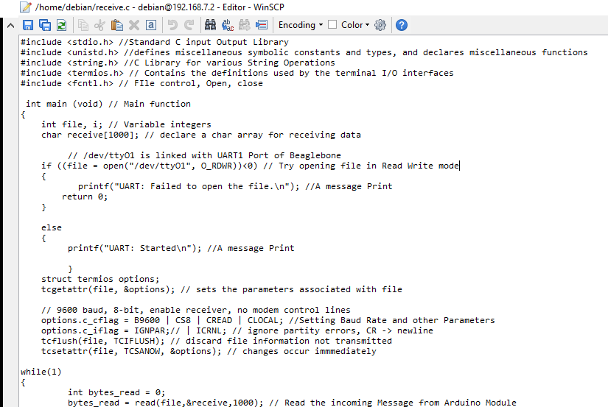
APPENDIX

